Slide 1


Workshop in information security
Presenting – Ori Petel

Slide 2
Main Goal - building a firewall
Extending the kernel using kernel modules
Monitoring the traffic using NetFilter
Stateless packet inspection
Statefull packet inspection
Adding game changer blades:
IPS – Intrusion Prevention System
DLP – Data leak Prevention
Kernel side infrastructure
User side interface
Man In The Middle technique
Rerouting & Faking packets
Proxy side programs
Constructing HTTP & FTP server
…
……..
……………..

Slide 3
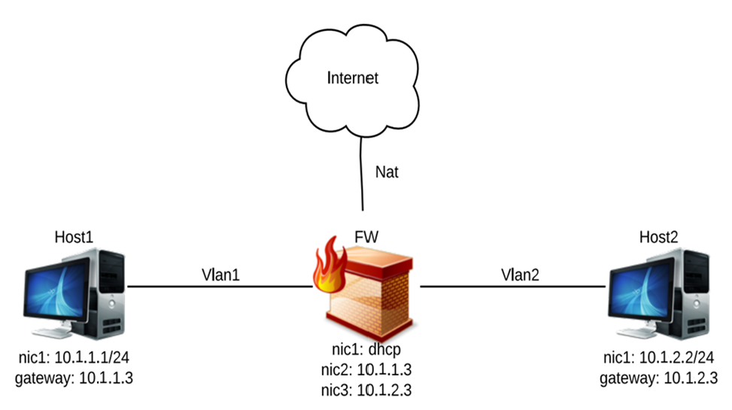


The setup
Internal
External

Slide 4
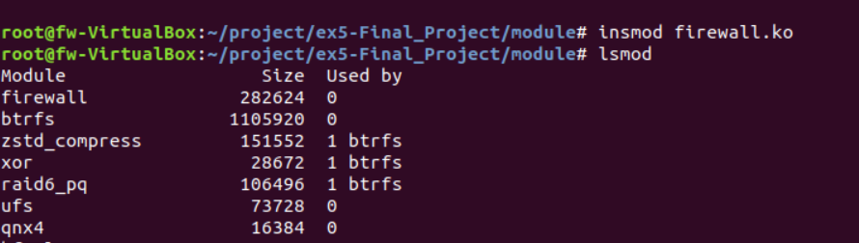
create a module
1st step

Slide 5
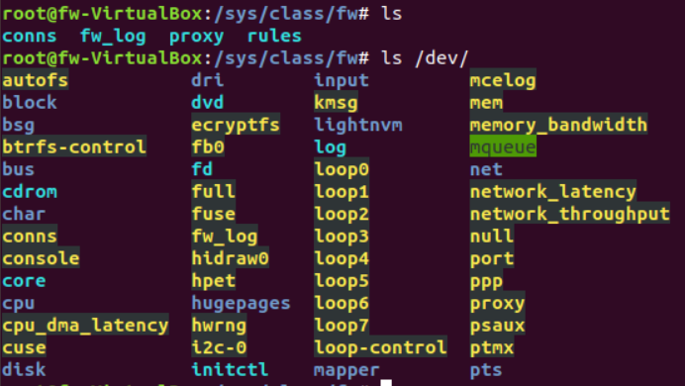
connect devices
2nd step

Slide 6
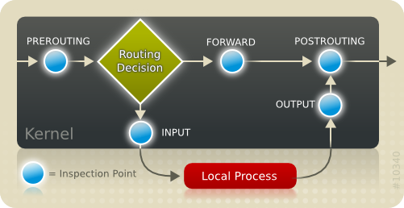
Monitor traffic
3st step
NetFilter – a powerful API to handle and examine packets from the internet

Slide 7
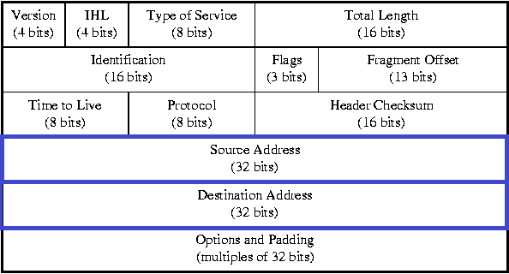
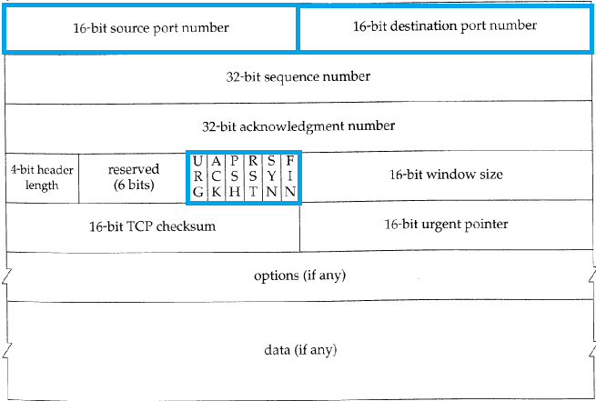
Stateless Inspection
4th step
Examine each packet individually , and enforce according to the rule table.
- Works in Network and Transport layers
Direction | Src address | Dst address | Protocol | Src port | Dst port | Syn/Ack | Action
In | Any | Network | any | any | 80 | Any | deny

Slide 8
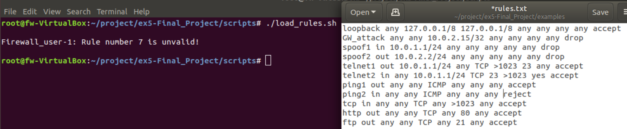
Firewall – Rule table

Slide 9
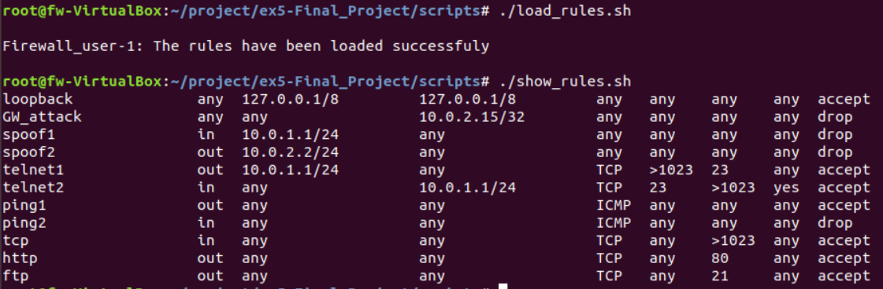
Firewall – Rule table

Slide 10
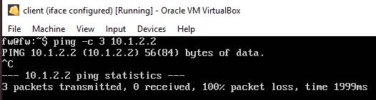
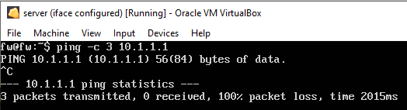
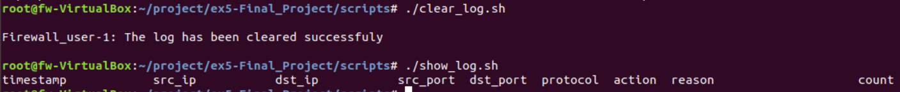
Firewall – log
Internal
Clear log
External
Accepted!

Slide 11
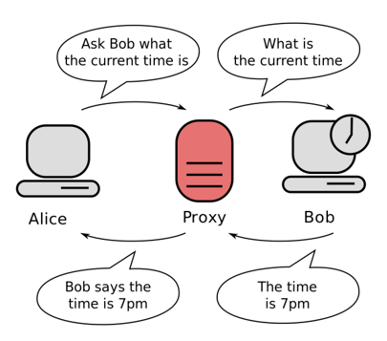
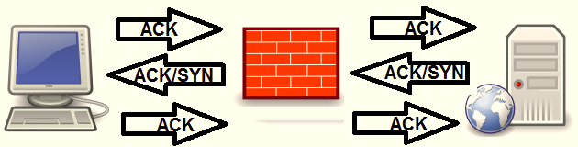
Statefull Inspection
5th step
Idea: examine each packet as part of a stream , look at the content.
- Works in Application layer
Deep inspection – MITM
Shallow inspection – State Enforcement

Slide 12
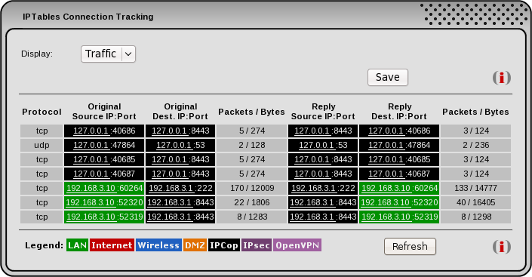


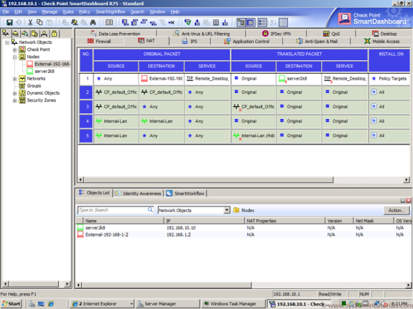
The framework
Dynamic connection table
Ack == 1
Ack == 1
Static rule table
Ack == 0
Ack == 0

Slide 13
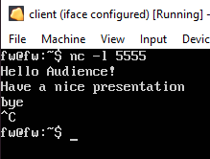
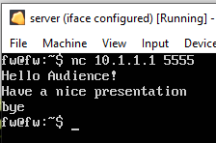
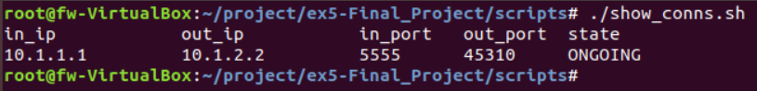
Firewall – connections
Host TCP connection
Client TCP connection
LOG:
Verified 3-way handshake
Live Connections:

Slide 14
Deep Inspection
Missions:
Block an HTTP response of type “text/csv” or “application/zip”. This information can be found in HTTP header
Dynamically allow active FTP data connections. This information can be found in FTP header
Application Layer

Slide 15
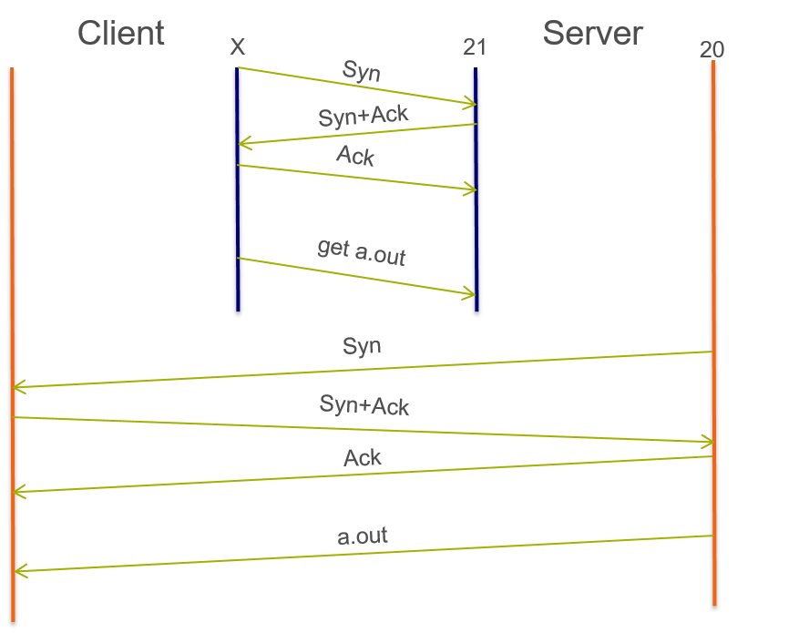
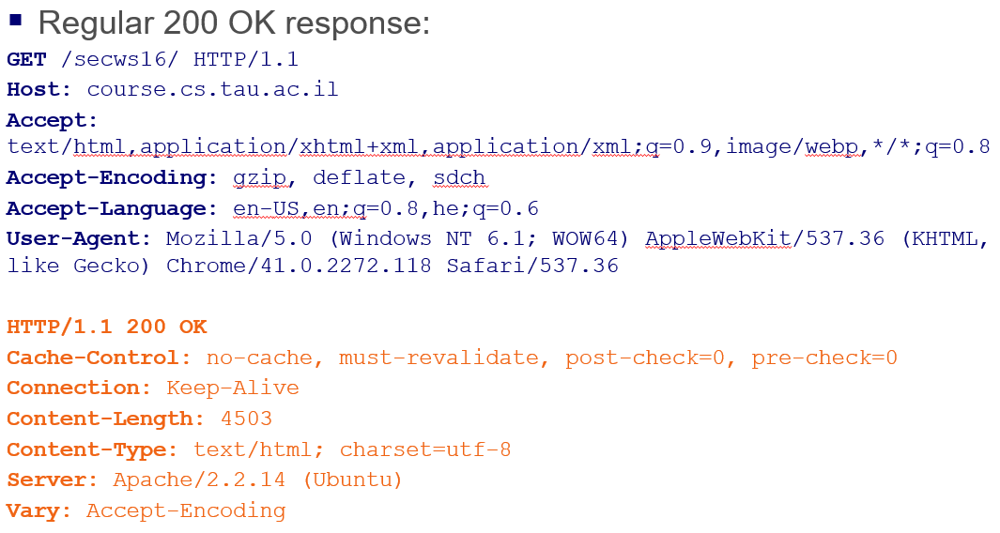
HTTP
FTP

Slide 16
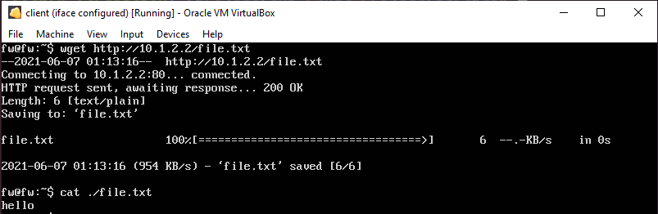
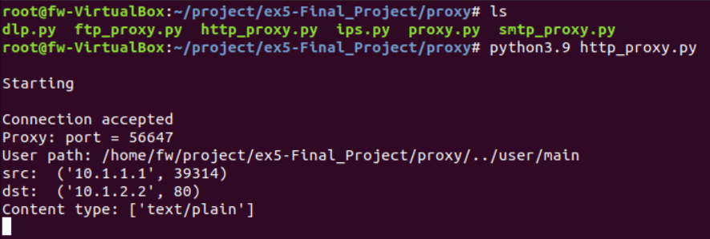
Deep Inspection in action
Client – valid HTTP request
Proxy side “behind the scene”

Slide 17
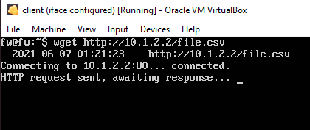
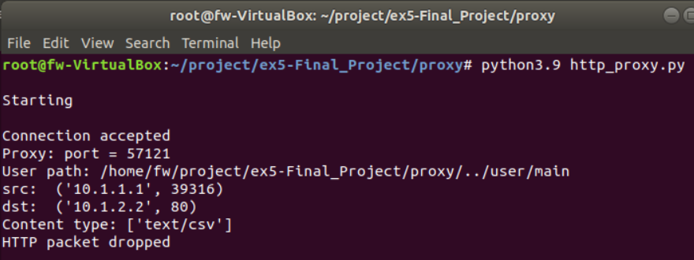
Deep Inspection in action
Client – invalid HTTP request
Proxy side “behind the scene”:

Slide 18
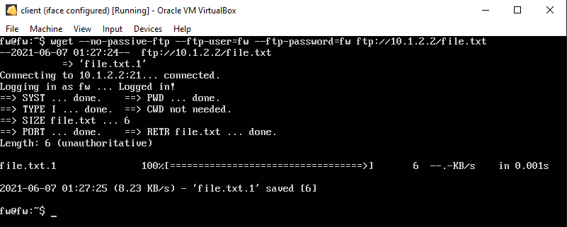
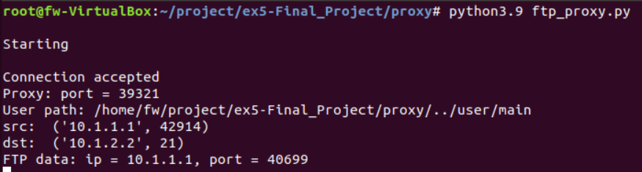
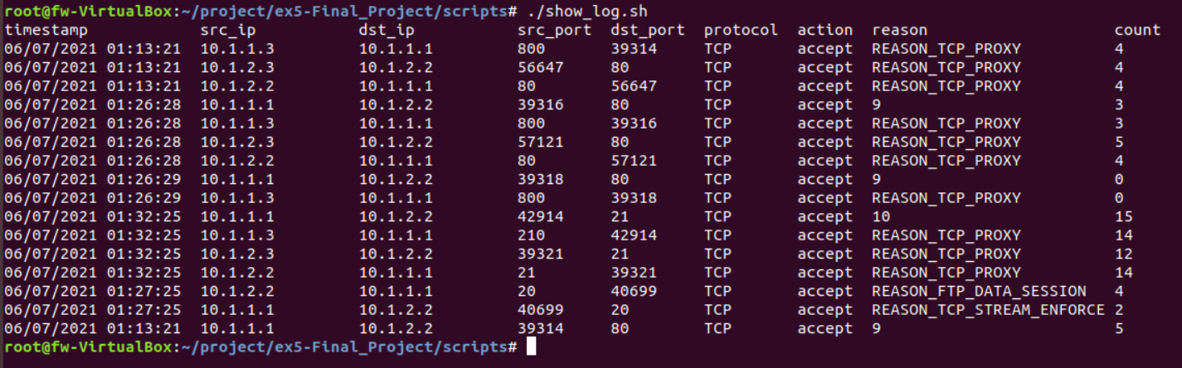
Deep Inspection in action
Client – active FTP request
Proxy side “behind the scene”:
Kernel Side: What really going on

Slide 19
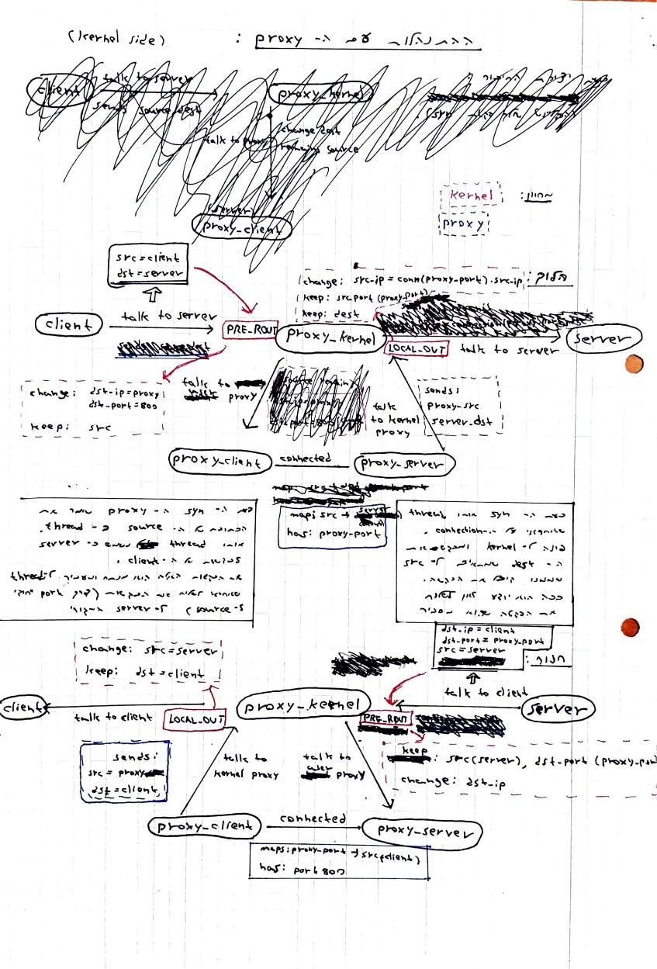
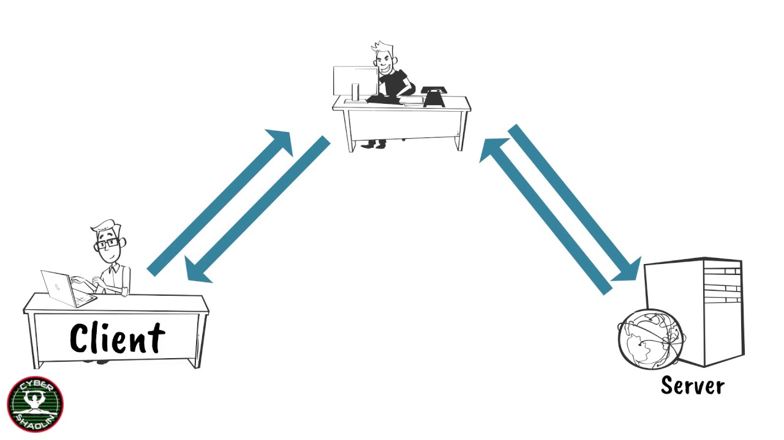
MY biggest challenge
Constructing the Proxy !
IP S / Port 80
IP C / Port Y
IP C / Port X
IP S / Port 80

Slide 20


IPS – Intrusion prevention system
Metasploit Module

Slide 21


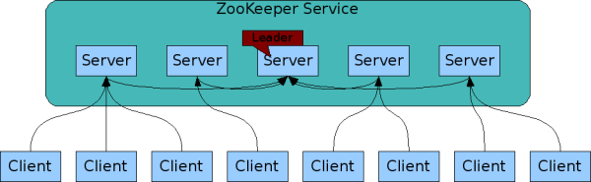
Apache zookeeper
A distributed, open-source coordination service for distributed application.
Relive distributed applications the responsibility of implementing coordination service from scratch.
Exposes a simple set of primitives that distributed applications can build upon. Therefore Provides very simple API

Slide 22
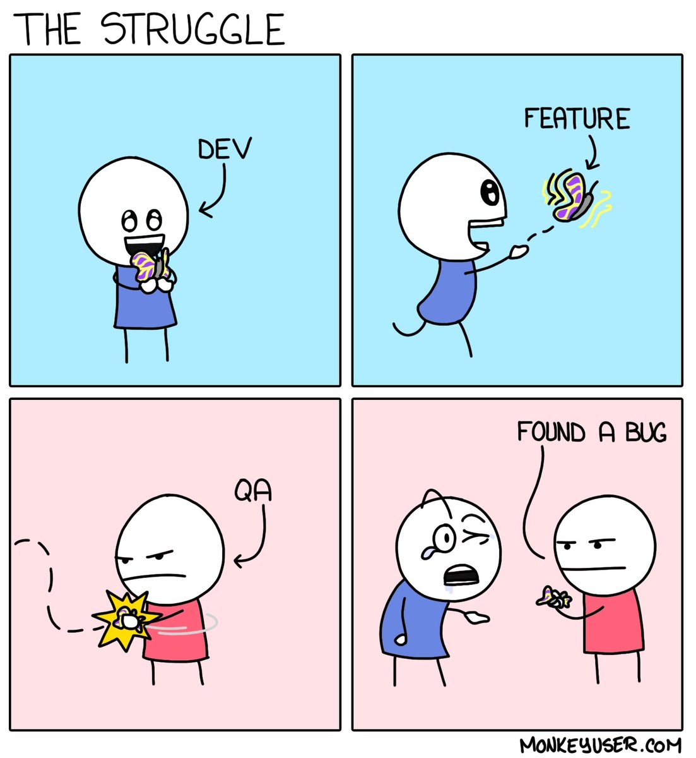



It’s not a bug, It’s a feature!
This service exposes an interface of small set of monitoring commands called ‘The 4 letter words’.
Those commands can be sent without any authentications via telnet or ‘plain’ TCP over the port 2181 / 2185.
By default 4-letter-word commands are disabled – you must enable them when configuring the ZooKeeper.
Juushya G.

Slide 23
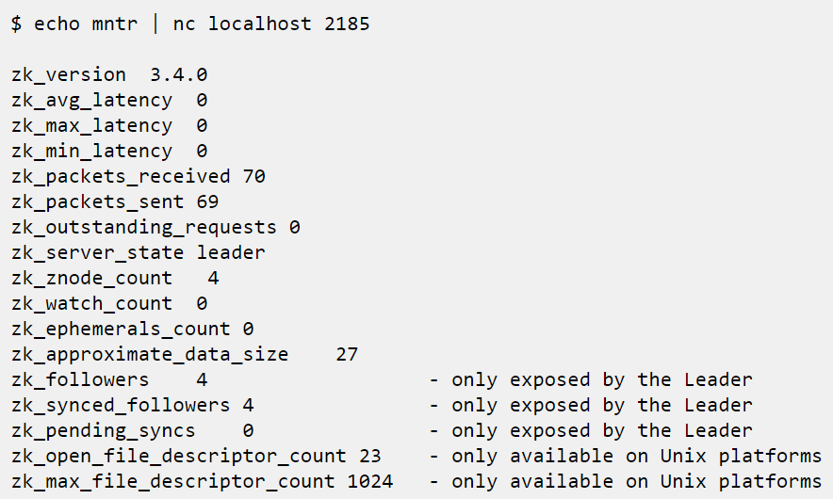
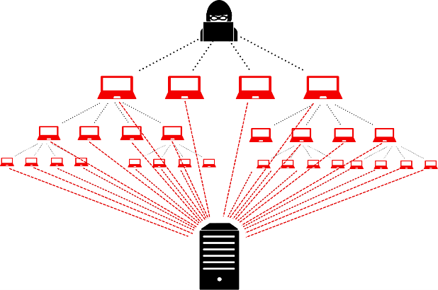
Exploitation - Information Disclosure
If not used carefully this "feature" can be exploited by malicious causes.
Such innocent command can be used for DDOS attacks on the server.

Slide 24

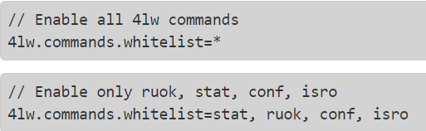
Protection – user level
zookeeper.properties
Pros:
Supported by the API
Doesn't require external tools
Cons:
Cannot distinguish “good” and “bad” users
Cannot allow risky (but useful) commands

Slide 25
Protection – transport layer
Blocking based on the packet’s header and not its content.
Using the stateless packet inspection.
Action | Ack | Dst_port | Src_port | protocol | dst_ip | src_ip | direction | name
drop | any | 2181 | any | TCP | any | any | in | ZooKeeper
Pros:
Open for internal users
Very small delay
Cons:
High granularity filtering
Blocks any communication to the outside world

Slide 26
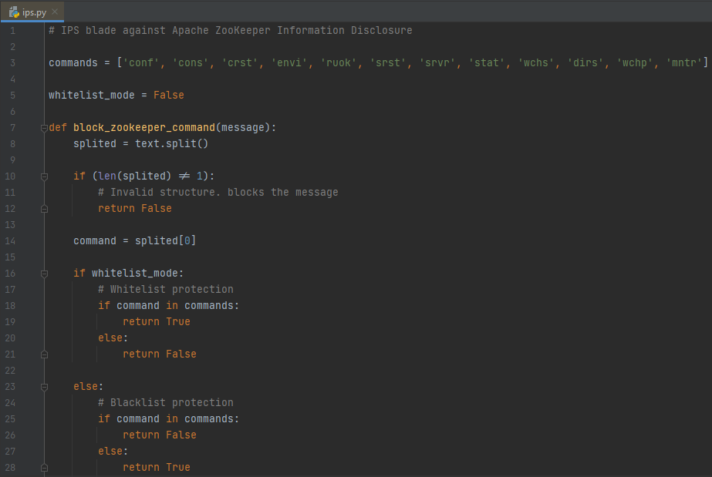
Protection – application layer
Detecting the commands in the packet’s content
Using statefull packet inspection
Pros:
Low granularity filtering
Distinguishes “good” and “bad” users.
Allows traffic from the outside world.
Cons:
High delay
Best solution so far !

Slide 27


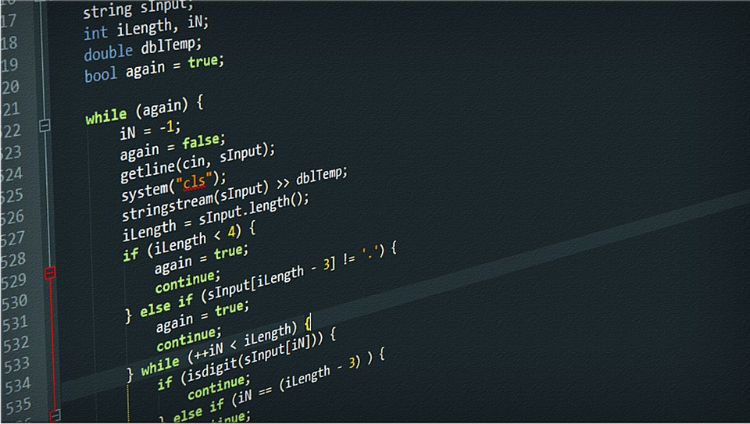
DLP – Data leak prevention

Slide 28
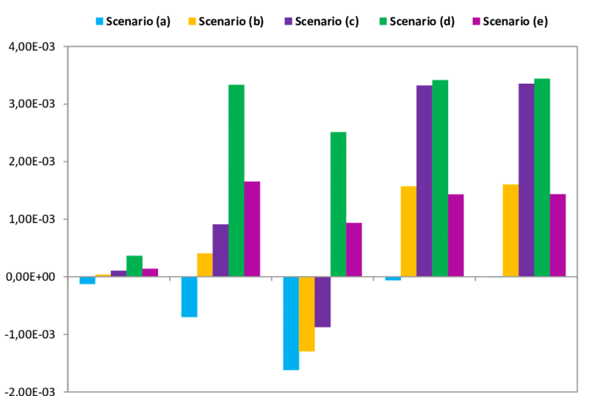
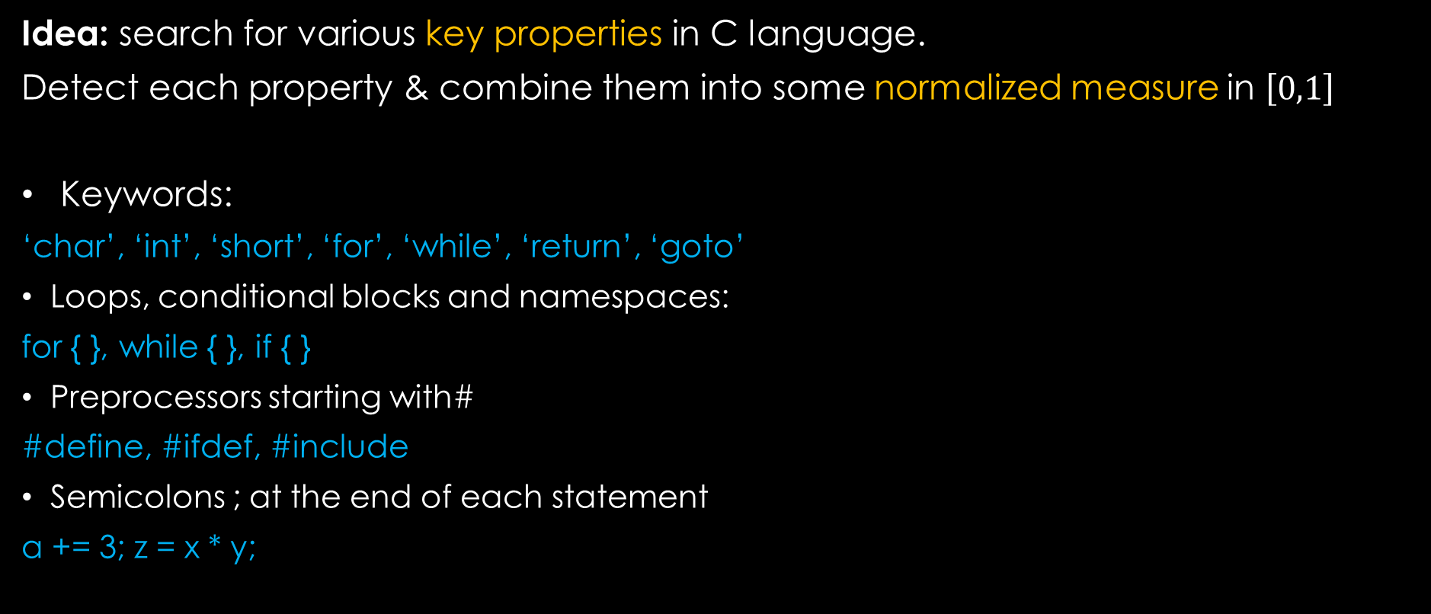
C detection
Idea: search for various key properties in C language.
Detect each property & combine them into some normalized measure in $\left[0,1\right]$
Keywords:
‘char’, ‘int’, ‘short’, ‘for’, ‘while’, ‘return’, ‘goto’
Loops, conditional blocks and namespaces:
for { }, while { }, if { }
Preprocessors starting with#
#define, #ifdef, #include
Semicolons ; at the end of each statement
a += 3; z = x * y;

Slide 29
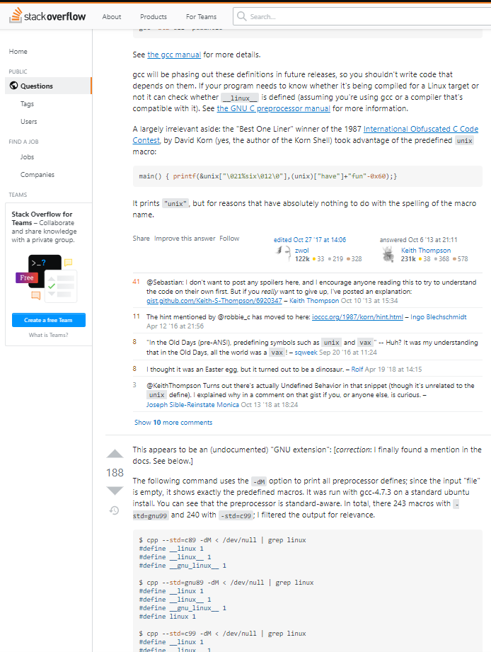
Problems
Algorithm: “C code”
Semicolons
Dependencies
Double counting
More…

Slide 30
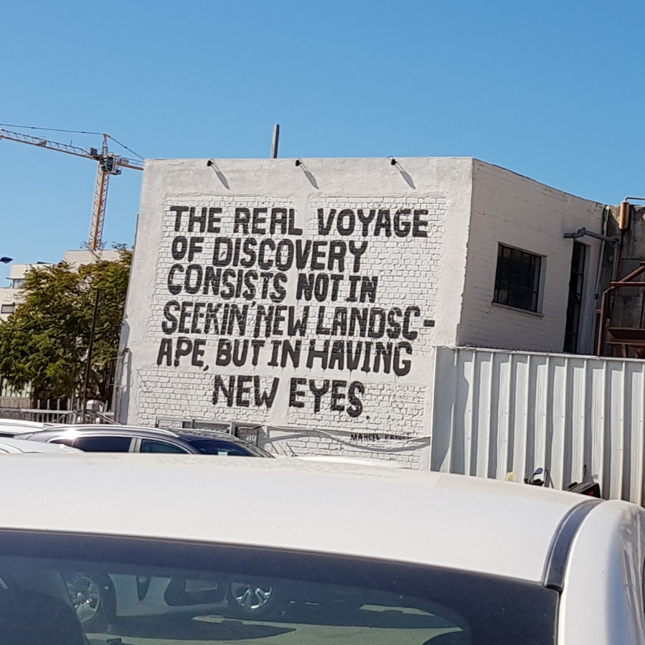
c detection – Solution
Solution:
Relate each line as part of a wide context.
Analyze the structure of the text.
Change the point of view.

Slide 31
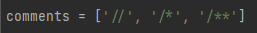
c detection – the algorithm
The work assumption: the text is a C code, unless proven wrong.
MACROS – Detect & Substitute (#def, #include…)
Comments – Detect & Separate
Semicolons – Split & Format
Declaration – Detect & Store (for later use)
Control blocks – Delimit & Identify
Assignments – Detect (using step 3)
Function calls – Detect (using step 3)
* Later stages are based on earlier stages.
Count “C lines” and “C blocks”…
Apply heuristic based thresholds.
If C code, then block the text

Slide 32

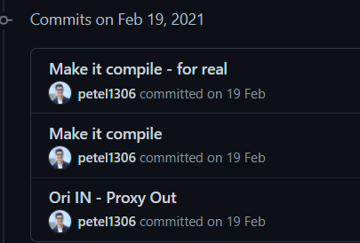
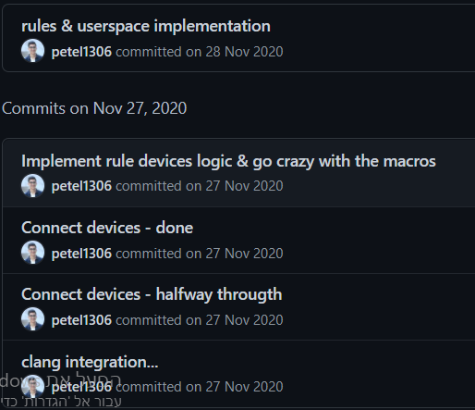
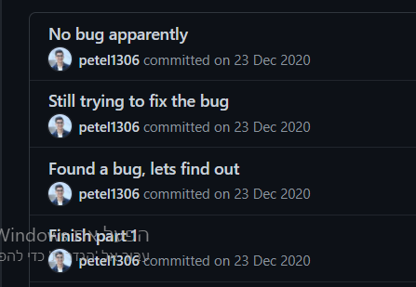
Funny story
Before
After

Slide 33

Questions

